Slide 1


School of Computing and Information Technology, Eastern International University (EIU) - Vietnam

Slide 2


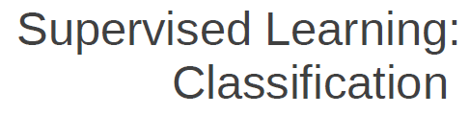



School of Computing and Information Technology, Eastern International University (EIU) - Vietnam

Slide 3
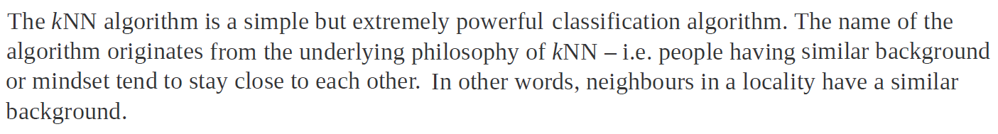
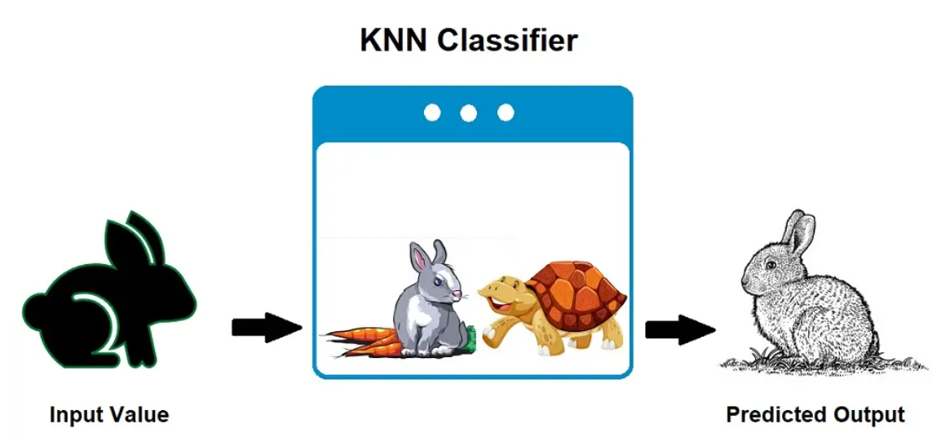
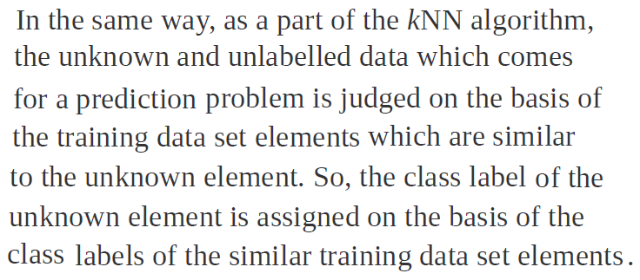
School of Computing and Information Technology, Eastern International University (EIU) - Vietnam

Slide 4
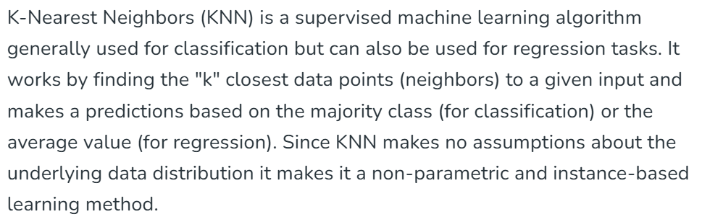
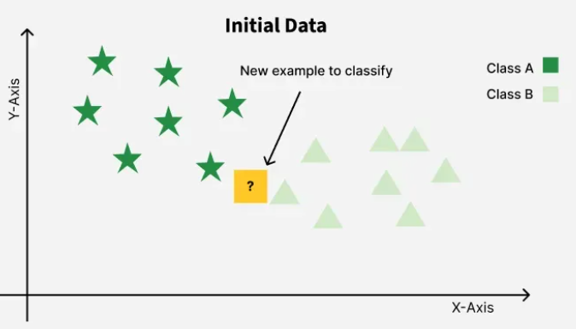
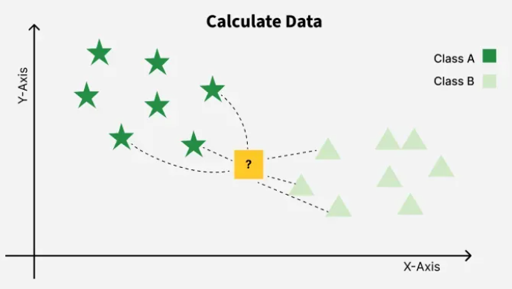
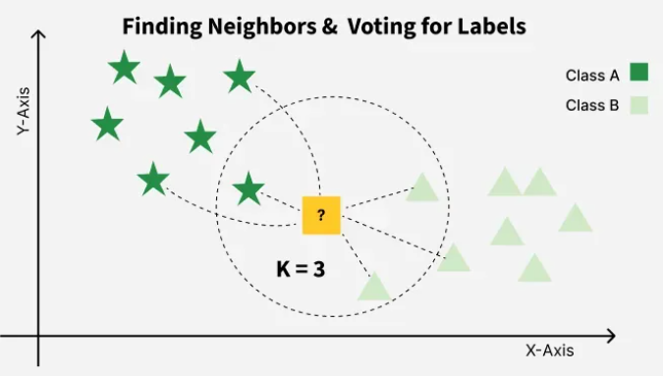
It was first developed by Evelyn Fix and Joseph Hodges in 1951 and later expanded by Thomas Cover.
School of Computing and Information Technology, Eastern International University (EIU) - Vietnam

Slide 5
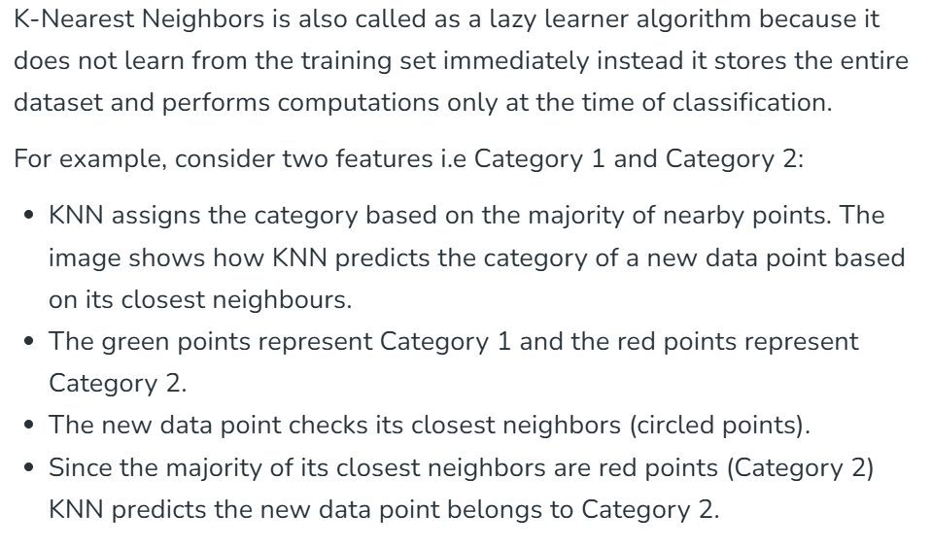
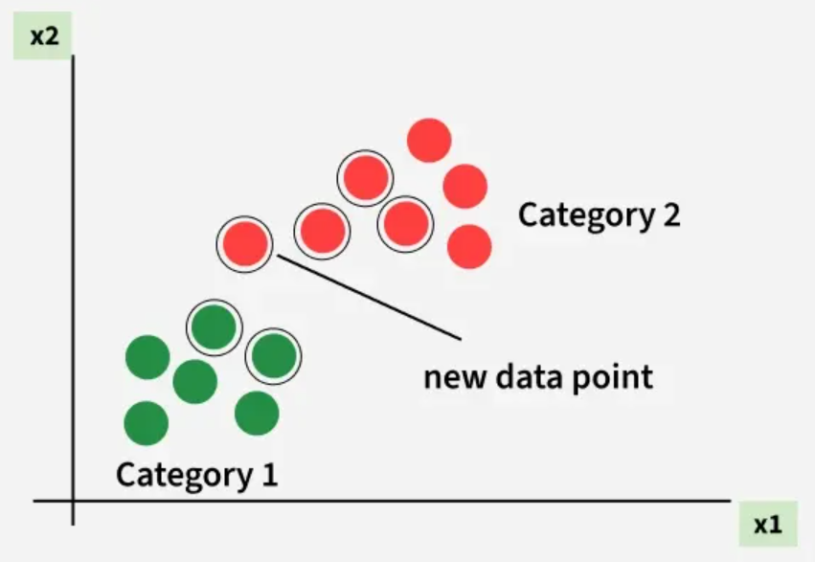
School of Computing and Information Technology, Eastern International University (EIU) - Vietnam

Slide 6
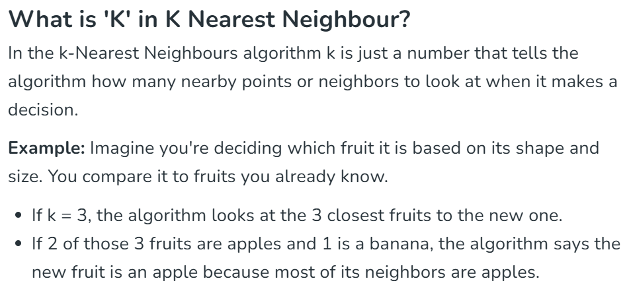


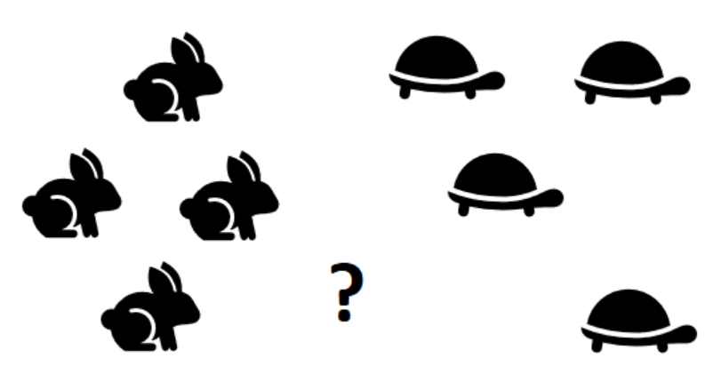
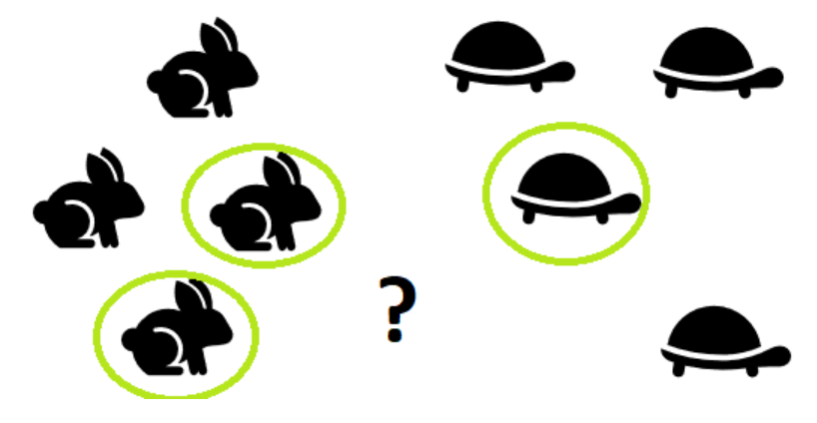
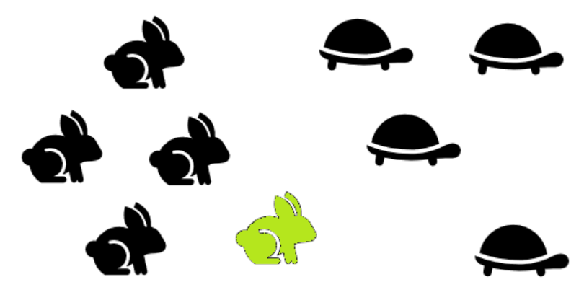
School of Computing and Information Technology, Eastern International University (EIU) - Vietnam

Slide 7
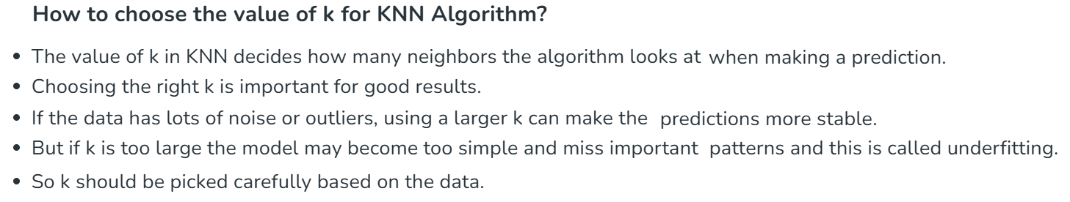
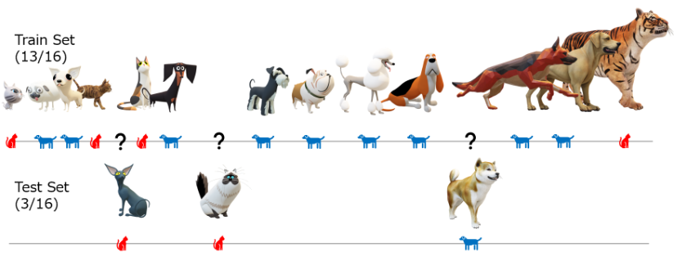
School of Computing and Information Technology, Eastern International University (EIU) - Vietnam

Slide 8
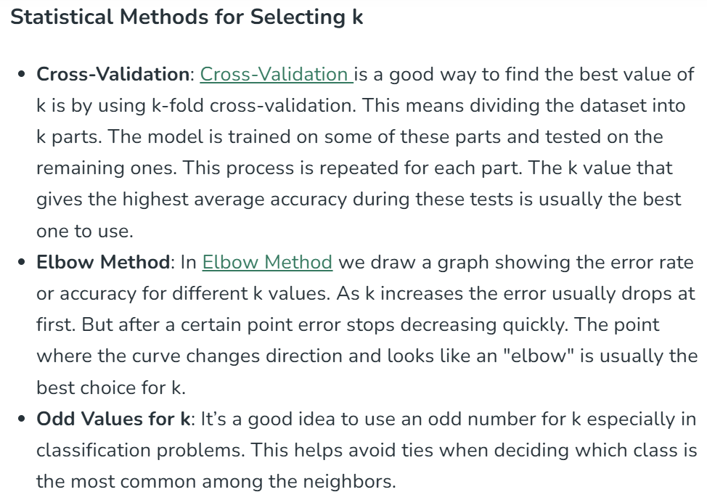
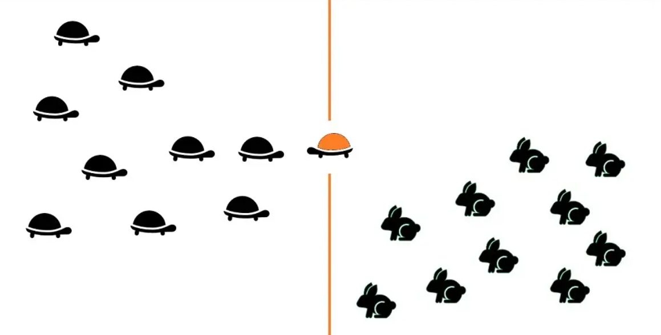
School of Computing and Information Technology, Eastern International University (EIU) - Vietnam

Slide 9
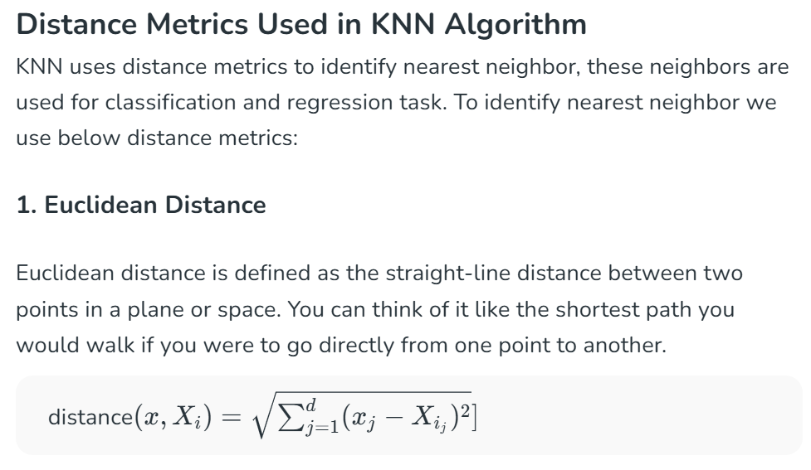
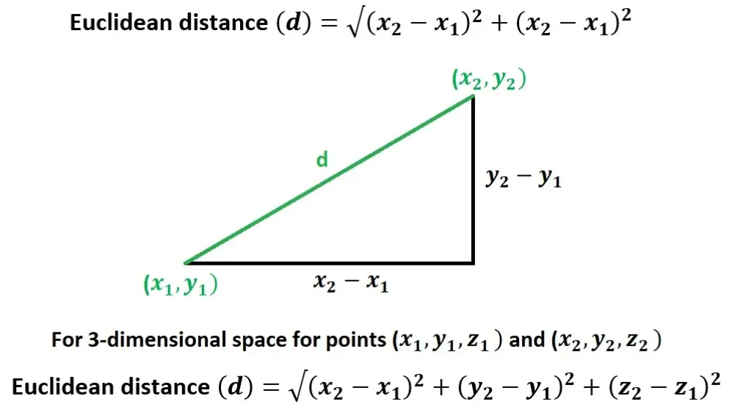
School of Computing and Information Technology, Eastern International University (EIU) - Vietnam

Slide 10
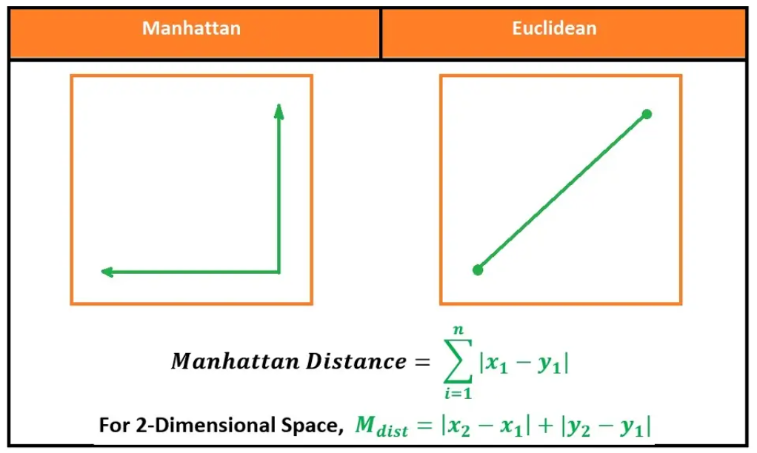
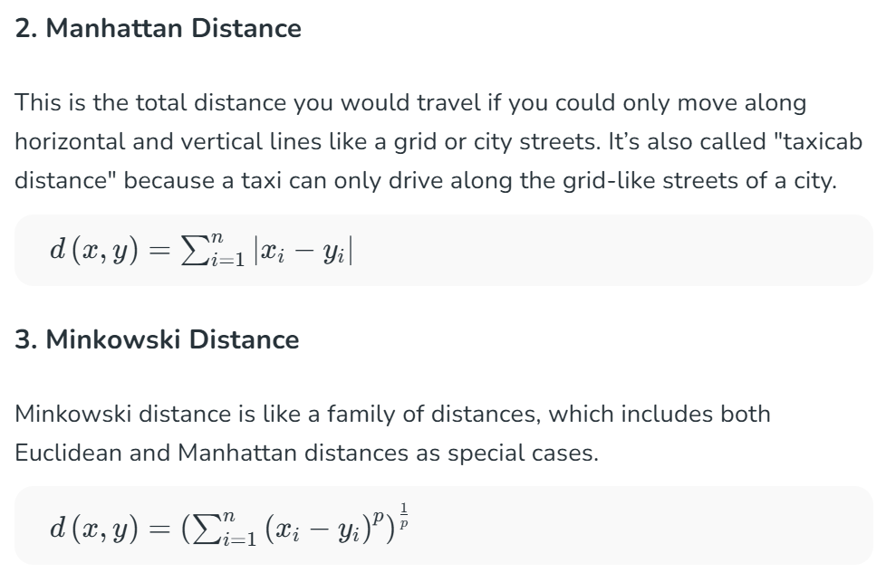
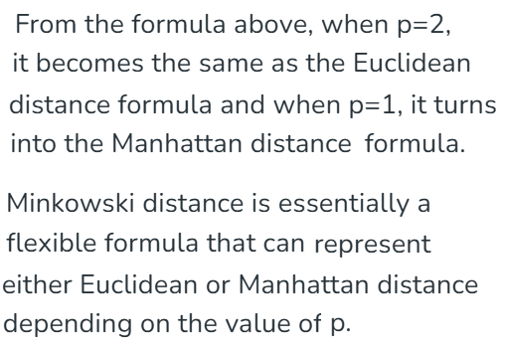
School of Computing and Information Technology, Eastern International University (EIU) - Vietnam

Slide 11

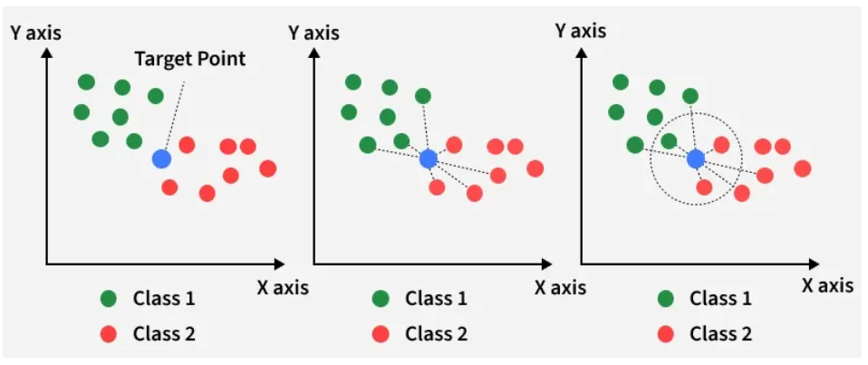
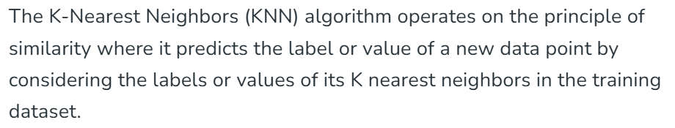
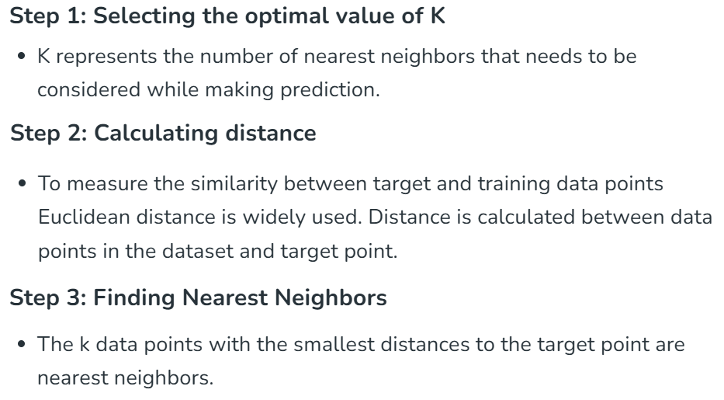
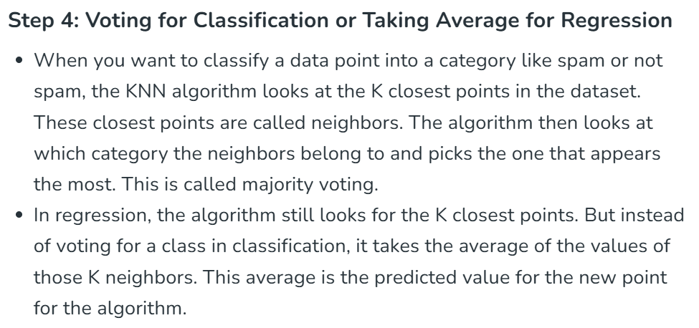
School of Computing and Information Technology, Eastern International University (EIU) - Vietnam

Slide 12
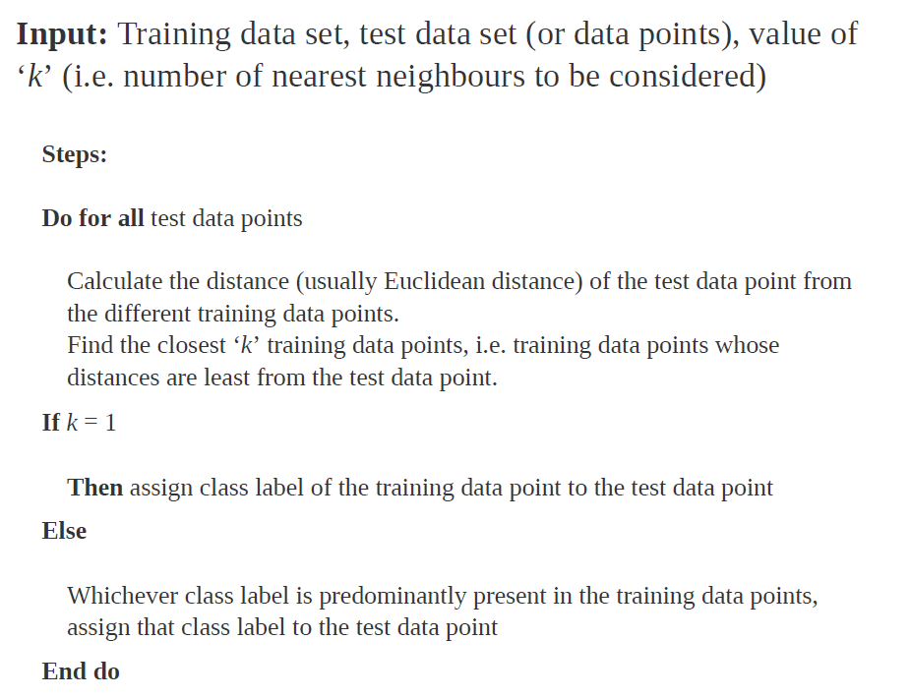
School of Computing and Information Technology, Eastern International University (EIU) - Vietnam

Slide 13
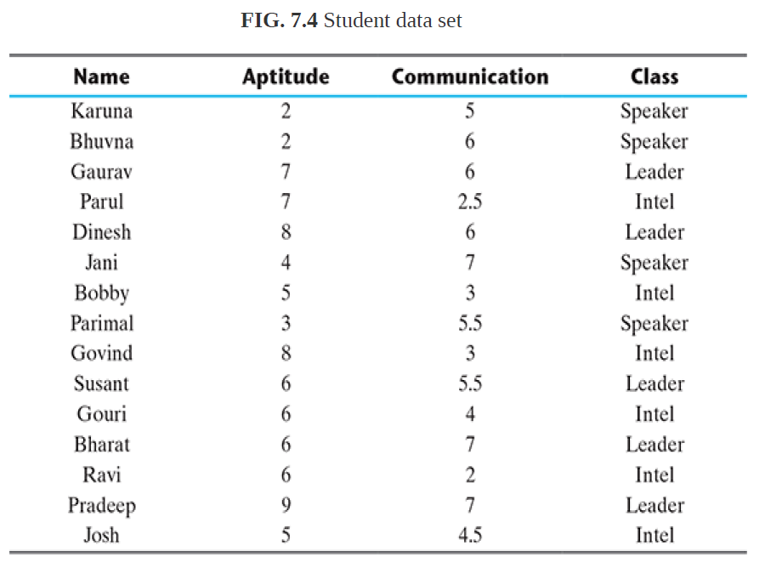

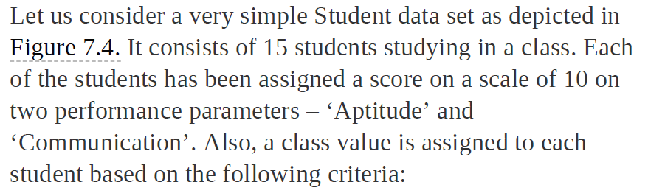
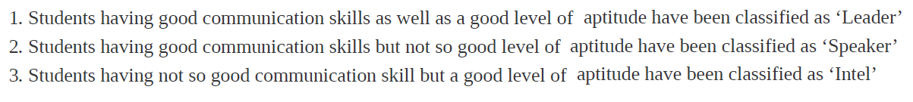
School of Computing and Information Technology, Eastern International University (EIU) - Vietnam

Slide 14
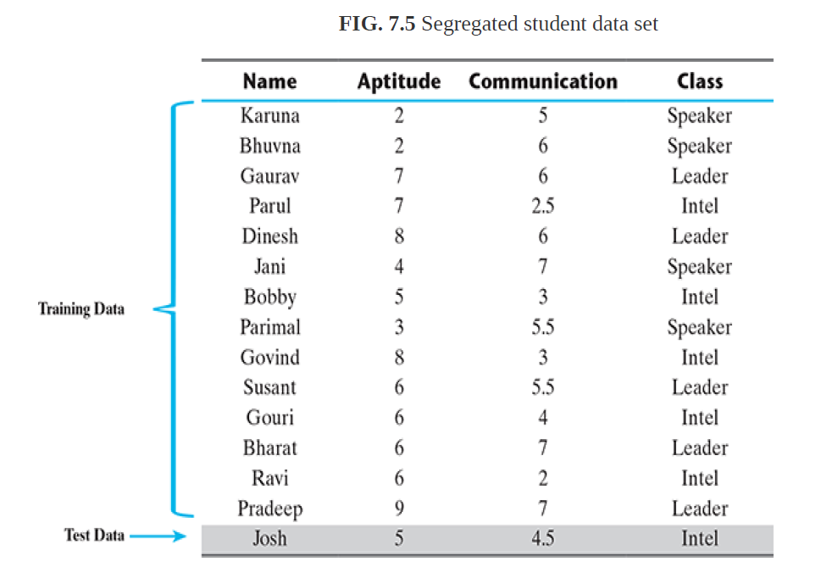
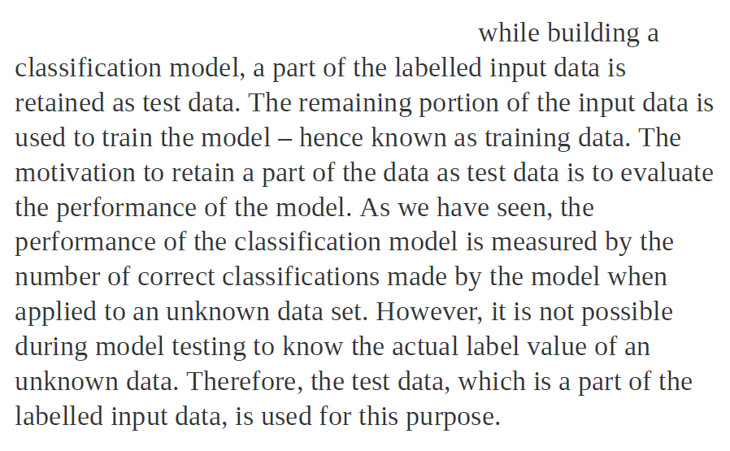
School of Computing and Information Technology, Eastern International University (EIU) - Vietnam

Slide 15
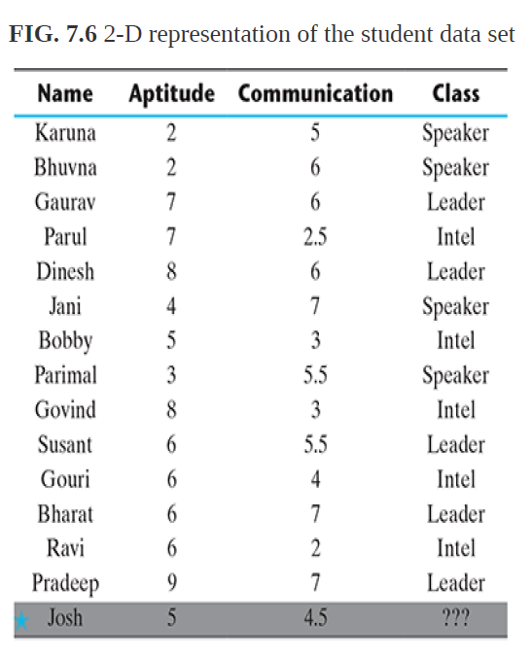
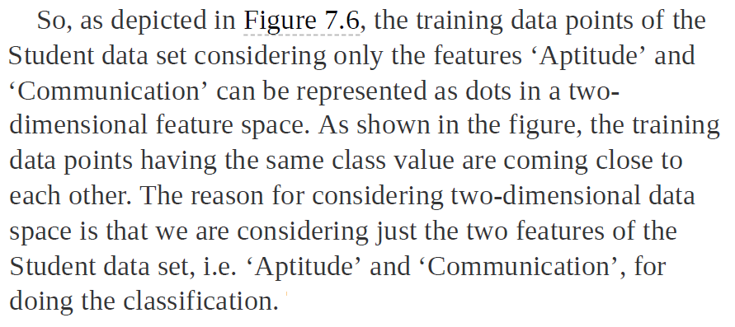
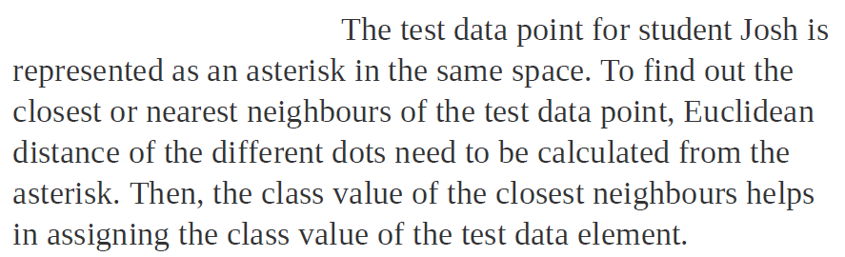
School of Computing and Information Technology, Eastern International University (EIU) - Vietnam

Slide 16
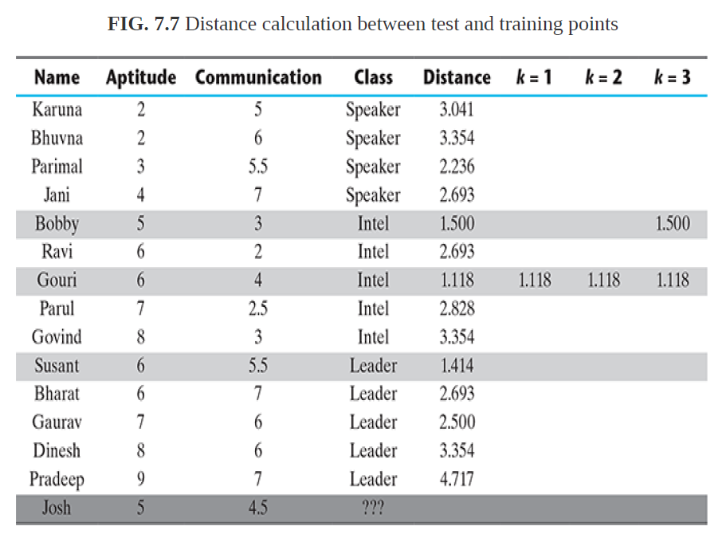
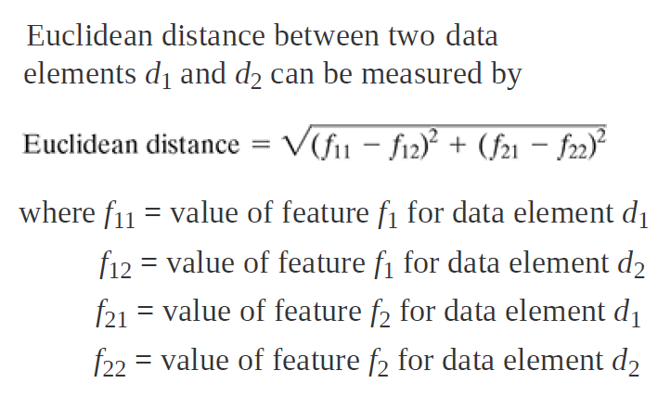
School of Computing and Information Technology, Eastern International University (EIU) - Vietnam

Slide 17
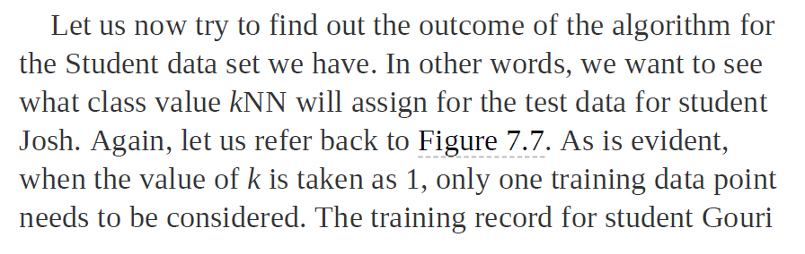
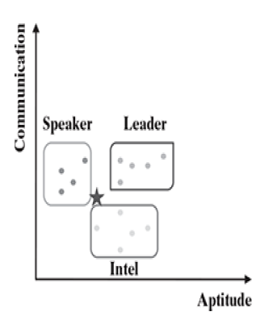
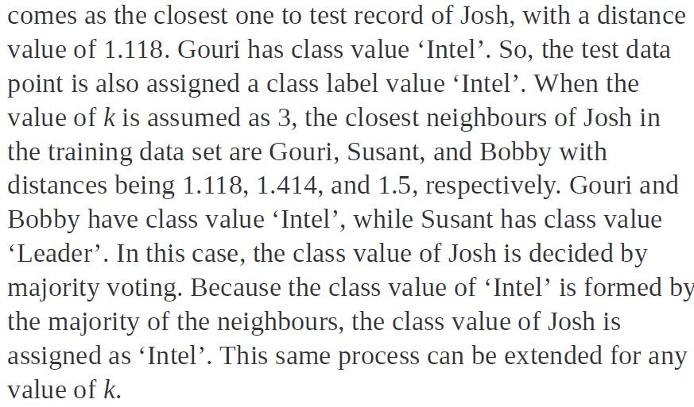

Slide 18
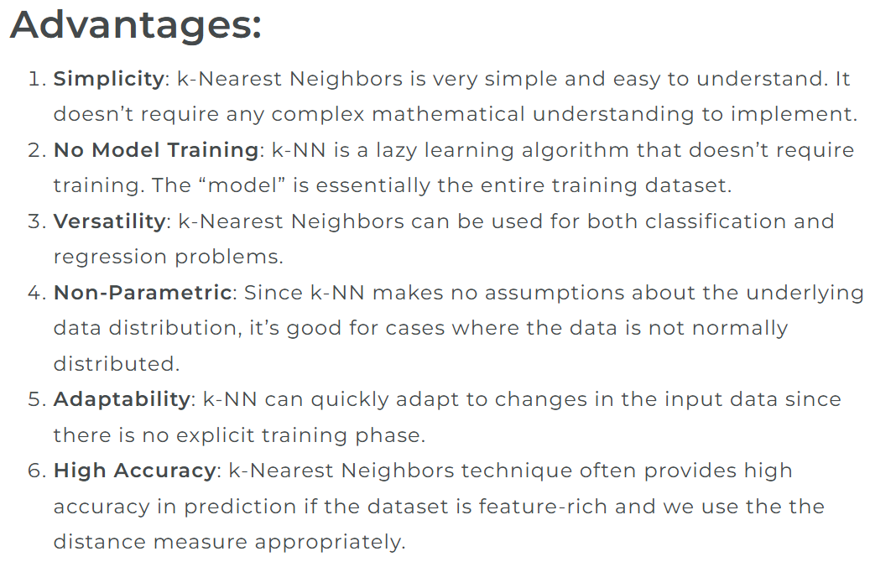
School of Computing and Information Technology, Eastern International University (EIU) - Vietnam

Slide 19
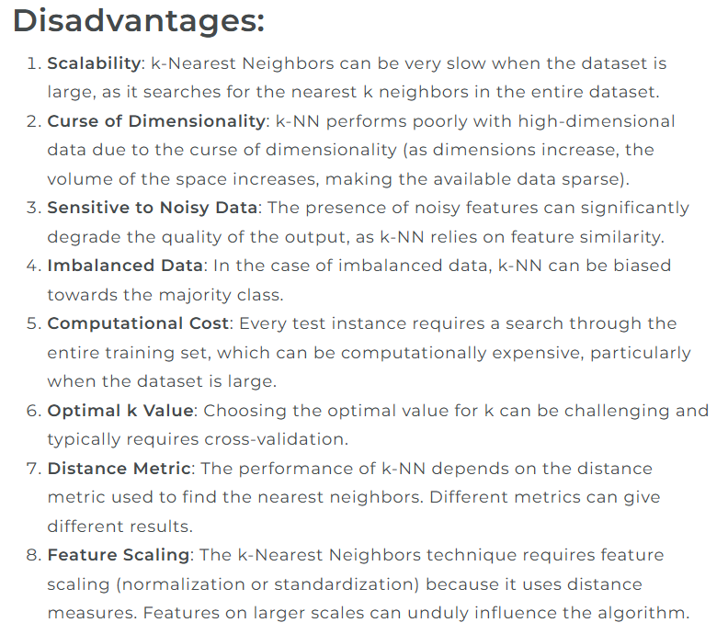
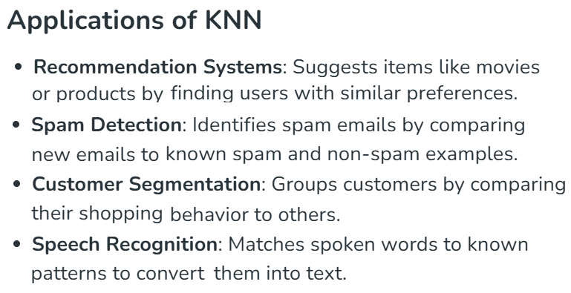

Slide 20
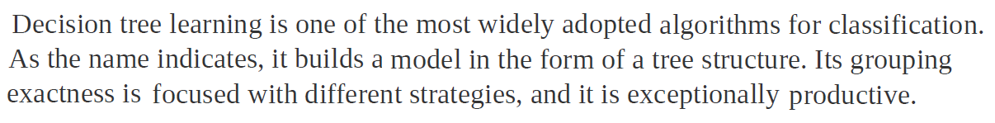
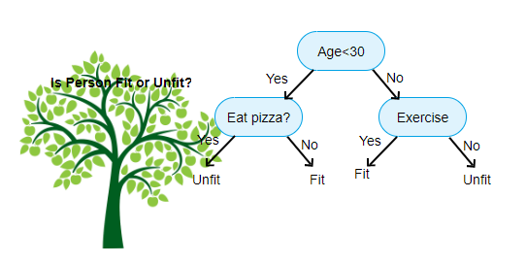
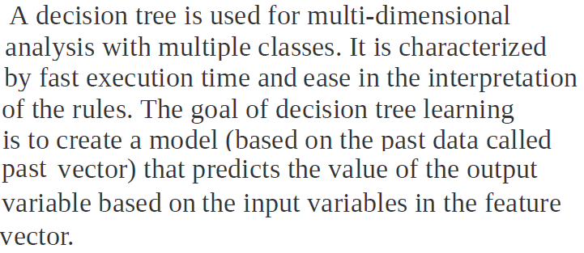
School of Computing and Information Technology, Eastern International University (EIU) - Vietnam

Slide 21
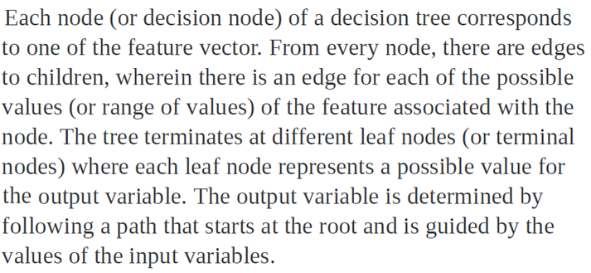
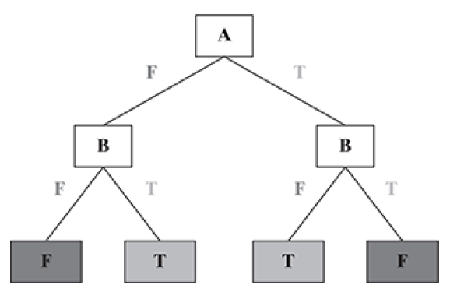
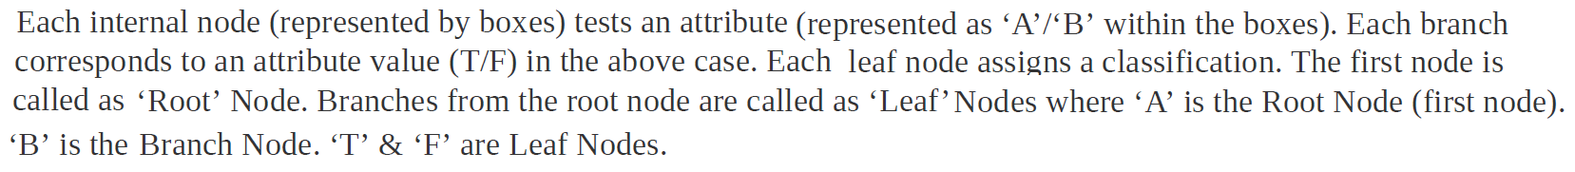
School of Computing and Information Technology, Eastern International University (EIU) - Vietnam

Slide 22


School of Computing and Information Technology, Eastern International University (EIU) - Vietnam

Slide 23


School of Computing and Information Technology, Eastern International University (EIU) - Vietnam

Slide 24



School of Computing and Information Technology, Eastern International University (EIU) - Vietnam

Slide 25



School of Computing and Information Technology, Eastern International University (EIU) - Vietnam

Slide 26


School of Computing and Information Technology, Eastern International University (EIU) - Vietnam

Slide 27



School of Computing and Information Technology, Eastern International University (EIU) - Vietnam

Slide 28



School of Computing and Information Technology, Eastern International University (EIU) - Vietnam

Slide 29



School of Computing and Information Technology, Eastern International University (EIU) - Vietnam

Slide 30



School of Computing and Information Technology, Eastern International University (EIU) - Vietnam

Slide 31

School of Computing and Information Technology, Eastern International University (EIU) - Vietnam

Slide 32

School of Computing and Information Technology, Eastern International University (EIU) - Vietnam

Slide 33

School of Computing and Information Technology, Eastern International University (EIU) - Vietnam

Slide 34



School of Computing and Information Technology, Eastern International University (EIU) - Vietnam

Slide 35





School of Computing and Information Technology, Eastern International University (EIU) - Vietnam

Slide 36



School of Computing and Information Technology, Eastern International University (EIU) - Vietnam

Slide 37

School of Computing and Information Technology, Eastern International University (EIU) - Vietnam

Slide 38


School of Computing and Information Technology, Eastern International University (EIU) - Vietnam

Slide 39




School of Computing and Information Technology, Eastern International University (EIU) - Vietnam

Slide 40



School of Computing and Information Technology, Eastern International University (EIU) - Vietnam

Slide 41




School of Computing and Information Technology, Eastern International University (EIU) - Vietnam

Slide 42





School of Computing and Information Technology, Eastern International University (EIU) - Vietnam

Slide 43




Slide 44





Slide 45


School of Computing and Information Technology, Eastern International University (EIU) - Vietnam

Slide 46



School of Computing and Information Technology, Eastern International University (EIU) - Vietnam

Slide 47





Slide 48


School of Computing and Information Technology, Eastern International University (EIU) - Vietnam

Slide 49




School of Computing and Information Technology, Eastern International University (EIU) - Vietnam

Slide 50

School of Computing and Information Technology, Eastern International University (EIU) - Vietnam

Slide 51



School of Computing and Information Technology, Eastern International University (EIU) - Vietnam

Slide 52




School of Computing and Information Technology, Eastern International University (EIU) - Vietnam

Slide 53



School of Computing and Information Technology, Eastern International University (EIU) - Vietnam

Slide 54




School of Computing and Information Technology, Eastern International University (EIU) - Vietnam

Slide 55





Slide 56






Slide 57



School of Computing and Information Technology, Eastern International University (EIU) - Vietnam

Slide 58





School of Computing and Information Technology, Eastern International University (EIU) - Vietnam

Slide 59

School of Computing and Information Technology, Eastern International University (EIU) - Vietnam

Slide 60

School of Computing and Information Technology, Eastern International University (EIU) - Vietnam

Slide 61

School of Computing and Information Technology, Eastern International University (EIU) - Vietnam

Slide 62





Slide 63






School of Computing and Information Technology, Eastern International University (EIU) - Vietnam

Slide 64





School of Computing and Information Technology, Eastern International University (EIU) - Vietnam

Slide 65



School of Computing and Information Technology, Eastern International University (EIU) - Vietnam

Slide 66




School of Computing and Information Technology, Eastern International University (EIU) - Vietnam

Slide 67


School of Computing and Information Technology, Eastern International University (EIU) - Vietnam

Slide 68


School of Computing and Information Technology, Eastern International University (EIU) - Vietnam

Slide 69





School of Computing and Information Technology, Eastern International University (EIU) - Vietnam

Slide 70


School of Computing and Information Technology, Eastern International University (EIU) - Vietnam

Slide 71



School of Computing and Information Technology, Eastern International University (EIU) - Vietnam

Slide 72


School of Computing and Information Technology, Eastern International University (EIU) - Vietnam

Slide 73




School of Computing and Information Technology, Eastern International University (EIU) - Vietnam

Slide 74






Slide 75

School of Computing and Information Technology, Eastern International University (EIU) - Vietnam

Slide 76



School of Computing and Information Technology, Eastern International University (EIU) - Vietnam

Slide 77




School of Computing and Information Technology, Eastern International University (EIU) - Vietnam

Slide 78








Slide 79









Slide 80








School of Computing and Information Technology, Eastern International University (EIU) - Vietnam

Slide 81








School of Computing and Information Technology, Eastern International University (EIU) - Vietnam

Slide 82


Slide 83



School of Computing and Information Technology, Eastern International University (EIU) - Vietnam

